Slide 1
Lecture 5 – Data Compression
Data compression and Coding fundamentals
Basic Data Compression Techniques
Data Compression and Coding Standards
JPEG
H.261(px64)
MPEG
DVI

Slide 2
Coding Requirements
Storage Requirements
Uncompressed audio:
8Khz, 8-bit quantization implies 64 Kbits to store per second
CD quality audio:
44.1Khz, 16-bit quantization implies storing 705.6Kbits/sec
PAL video format:
640X480 pixels, 24 bit quantization, 25 fps, implies storing 184,320,000 bits/sec = 23,040,000 bytes/sec
Bandwidth Requirements
uncompressed audio: 64Kbps
CD quality audio: 705.6Kbps
PAL video format: 184,320,000 bits/sec
COMPRESSION IS REQUIRED!!!!!!!

Slide 3
Coding Format Examples
JPEG for still images
H.261/H.263 for video conferencing, music and speech (dialog mode applications)
MPEG-1, MPEG-2, MPEG-4 for audio/video playback, VOD (retrieval mode applications)
DVI for still and continuous video applications (two modes of compression)
Presentation Level Video (PLV) - high quality compression, but very slow. Suitable for applications distributed on CD-ROMs
Real-time Video (RTV) - lower quality compression, but fast. Used in video conferencing applications.

Slide 4
Coding Requirements
Dialog mode applications
End-to-end Delay (EED) should not exceed 150-200 ms
Face-to-face application needs EED of 50ms (including compression and decompression).
Retrieval mode applications
Fast-forward and rewind data retrieval with simultaneous display (e.g. fast search for information in a multimedia database).
Random access to single images and audio frames, access time should be less than 0.5sec
Decompression of images, video, audio - should not be linked to other data units - allows random access and editing

Slide 5
Coding Requirements
Requirements for both dialog and retrieval mode applications
Support for scalable video in different systems.
Support for various audio and video rates.
Synchronization of audio-video streams (lip synchronization)
Economy of solutions
Compression in software implies cheaper, slower and low quality solution.
Compression in hardware implies expensive, faster and high quality solution.
Compatibility
e.g. tutoring systems available on CD should run on different platforms.

Slide 6
Classification of Compression Techniques
Entropy Coding
lossless encoding
used regardless of media’s specific characteristics
data taken as a simple digital sequence
decompression process regenerates data completely
e.g. run-length coding, Huffman coding, Arithmetic coding
Source Coding
lossy encoding
takes into account the semantics of the data
degree of compression depends on data content.
E.g. content prediction technique - DPCM, delta modulation
Hybrid Coding (used by most multimedia systems)
combine entropy with source encoding
E.g. JPEG, H.263, DVI (RTV & PLV), MPEG-1, MPEG-2, MPEG-4

Slide 7
Types of compression
Symmetric Compression
Same time needed for decoding and encoding phases
Used for dialog mode applications
Asymmetric Compression
Compression process is performed once and enough time is available, hence compression can take longer.
Decompression is performed frequently and must be done fast.
Used for retrieval mode applications

Slide 8
Basic Data Compression Techniques
Entropy Coding - Run-length Encoding (RLE)
Variations of Run-length coding (Zero suppression)
Variations of run-length coding - Text compression
Variation of Run-length coding: Zero Compression
Variation of run-length coding - Diatomic Coding
Statistical Encoding (Frequency Dependent)
Huffman Encoding (Statistical encoding technique)
Arithmetic Encoding
Source Encoding - Differential Encoding
Delta Modulation

Slide 9
Entropy Coding - Run-length Encoding (RLE)
Content dependent coding
RLE replaces the sequence of same consecutive bytes with the number of occurrences.
The number of occurrences is indicated by a special flag - “!”
RLE Algorithm:
If the same byte occurred at least 4 times then count the number of occurrences
Write compressed data in the following format:
“the counted byte!number of occurrences”
Example
Uncompressed sequence - ABCCCCCCCCCDEFFFFGGG
Compressed sequence - ABC!9DEF!4GGG (from 20 to 13 bytes)

Slide 10
Variations of Run-length coding (Zero suppression)
Assumes that only one symbol appears very often - blank.
Algorithm:
single blanks are ignored
Starting with a sequence of 3 blanks, they are replaced by an M-byte and a byte with the number of blanks in the sequence.
E.g. 3 - 258 zero bytes can be reduced to 2 bytes.
Substitution depends on relative position.
Extended definitions are possible
If M4 == 8 zero blanks, M5==16 zero bytes, M4M5 == 24 zero bytes.

Slide 11
Variations of run-length coding - Text compression
Patterns that occur frequently can be substituted by single bytes.
E.g. “Begin”, “end”, “if”…
Algorithm:
Use an ESC byte to indicate that an encoded pattern will follow.
The next byte is an index reference to one of 256 words (patterns).
Can be applied to still images, audio, video.
Not easy to identify small sets.

Slide 12
Variation of Run-length coding: Zero Compression
Used to encode long binary bit strings containing mostly zeros.
Each k-bit symbol tells how many 0’s occurred between consecutive 1’s.
e.g. 0000000 - 7 zeros to be encoded.
111 000 (3 bit symbol)
e.g. 000100000001101 (using 3 bit symbol)
011 111 000 001 (3-7-0-1 zeros between 1s)

Slide 13
Variation of run-length coding - Diatomic Coding
Determined frequently occuring pairs of bytes
e.g. an analysis of the English language yielded frequently used pairs - “th”, “in”, “he” etc..
Replace these pairs by single bytes that do not occur anywhere in the text (e.g. X)…
can achieve reduction of more than 10%

Slide 14
Statistical Encoding (Frequency Dependent)
Fixed length coding
Use equal number of bits to represent each symbol - message of N symbols requires L >= log_2(N) bits per symbol.
Good encoding for symbols with equal probability of occurrence. Not efficient if probability of each symbol is not equal.
Variable length encoding
frequently occurring characters represented with shorter strings than seldom occurring characters.
Statistical encoding is dependant on the frequency of occurrence of a character or a sequence of data bytes.
You are given a sequence of symbols: S1, S2, S3 and the probability of occurrence of each symbol P(Si) = Pi.

Slide 15
Huffman Encoding (Statistical encoding technique)
Characters are stored with their probabilities
Number of bits of the coded characters differs. Shortest code is assigned to most frequently occurring character.
To determine Huffman code, we construct a binary tree.
Leaves are characters to be encoded
Nodes contain occurrence probabilities of the characters belonging to the subtree.
0 and 1 are assigned to the branches of the tree arbitrarily - therefore different Huffman codes are possible for the same data.
Huffman table is generated.
Huffman tables must be transmitted with compressed data

Slide 16
Example of Huffman Encoding
P(A) = 0.16
P(CEDAB) = 1
0
1
P(B) = 0.51
P(C) = 0.09
P(D) = 0.13
P(CEDA) = 0.49
P(B) = 0.51
P(E) = 0.11
0
1
w(A) = 011
P(CE) = 0.20
P(DA) = 0.29
w(B) = 1
1
w(C) = 000
0
0
1
w(D) = 010
P(C) = 0.09
P(E) = 0.11
P(D) = 0.13
P(A) = 0.16
w(E) = 001

Slide 17
Arithmetic Encoding
Each symbol is coded by considering prior data
encoded sequence must be read from beginning; no random access possible.
Each symbol is a portion of a real number between 0 and 1.
Arithmetic vs. Huffman
Arithmetic encoding does not encode each symbol separately; Huffman encoding does.
Arithmetic encoding transmits only length of encoded string; Huffman encoding transmits the Huffman table.
Compression ratios of both are similar.

Slide 18
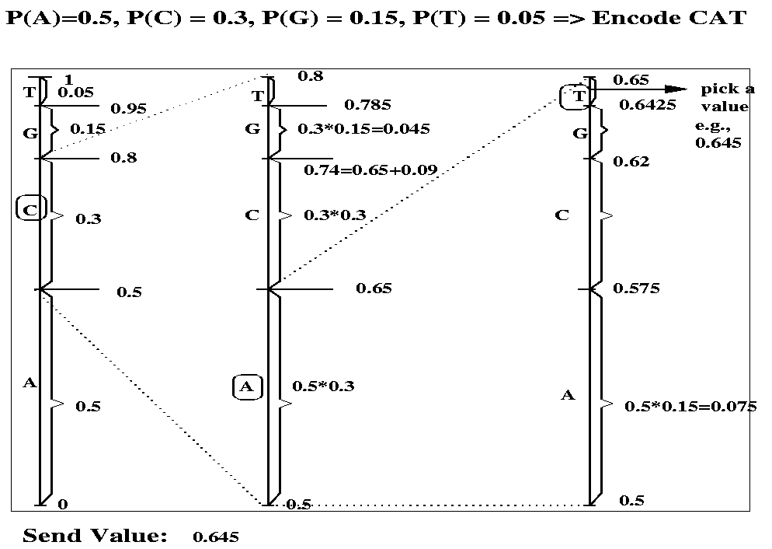

Slide 19
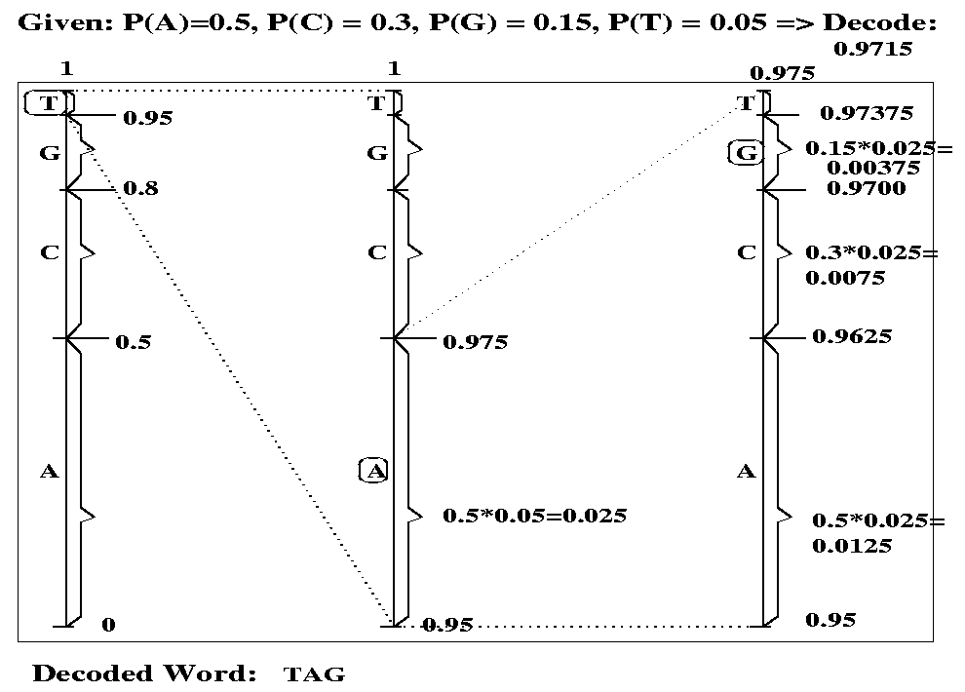

Slide 20
Source Encoding - Differential Encoding
Coding is lossy.
Consider sequences of symbols S1, S2, S3 etc. where values are not zeros but do not vary very much.
We calculate difference from previous value -- S1, S2-S1, S3-S2 etc.
E.g. Still image
Calculate difference between nearby pixels or pixel groups.
Edges characterized by large values, areas with similar luminance and chrominance are characterized by small values.
Zeros can be compressed by run-length encoding and nearby pixels with large values can be encoded as differences.

Slide 21
Differential Encoding (cont.)
Video applications
In a newscast or video phone, the background does not change often, hence we can use run-length encoding to compress the background.
In movies, the background changes - use motion compensation.
Compare blocks of 8X8 or 16x16 in subsequent pictures.
Find areas that are similar, but shifted to the left or right.
Encode motion using a “motion vector”.

Slide 22
Differential Encoding for Audio
Differential Pulse Code Modulation(DPCM)
When we use PCM, we get a sequence of PCM coded samples.
Represent first PCM sample as a whole and all the following samples as differences from the previous one.
Sample
difference
+
DPCM
Encoder
-
Previous
Sample
Difference
Sample
+
DPCM
Decoder
+
Previous
Sample

Slide 23
DPCM Example
Samples
0 0.25 0.5 0.75 0.25 0 -0.25 -0.5
000 001 010 011 001 000 100 101
0 0.25 0.25 0.25 -0.5 -0.25 -0.25 -0.25
00 01 01 01 11 10 10 10
Digital Code
Difference
Need only 2 bits to encode difference

Slide 24
Delta Modulation
Modification of DPCM
Uses only 1 bit to encode difference.
Sets 1 if the difference increases
Sets 0 if the difference decreases
Leads to inaccurate coding

Slide 25
Data Compression and Coding Standards:- JPEG
JPEG (Joint Photographic Expert Group)
What is JPEG?
Requirements on JPEG implementations
JPEG implementation is independent of image size and applicable to any image and pixel aspect ratio.
Image content may be of any complexity (with any statistical characteristics).
JPEG should achieve very good compression ratio and good quality image.
From the processing complexity of a software solution point of view: JPEG should run on as many available platforms as possible.
Sequential decoding (line-by-line) and progressive decoding (refinement of the whole image) should be possible.

Slide 26
Why JPEG
The compression ratio of lossless methods (e.g., Huffman, Arithmetic, LZW) is not high enough for image and video compression.
JPEG uses transform coding, it is largely based on the following observations:
Observation 1: A large majority of useful image contents change relatively slowly across images, i.e., it is unusual for intensity values to alter up and down several times in a small area, for example, within an 8 x 8 image block. A translation of this fact into the spatial frequency domain, implies, generally, lower spatial frequency components contain more information than the high frequency components which often correspond to less useful details and noises.
Observation 2: Experiments suggest that humans are more immune to loss of higher spatial frequency components than loss of lower frequency components.

Slide 27
Steps in Compression (Image)
Picture preparation
analog-to-digital conversion
generation of appropriate digital representation
image division into 8X8 blocks
fix the number of bits per pixel
Picture processing (compression algorithm)
transformation from spatial domain to frequency domain, e.g. DCT
DCT converts the information contained in a block(8x8) of pixels from spatial domain to the frequency domain.
A simple analogy: Consider a unsorted list of 12 numbers between 0 and 3 -> (2, 3, 1, 2, 2, 0, 1, 1, 0, 1, 0, 0). Consider a transformation of the list involving two steps (1.) sort the list (2.) Count the frequency of occurrence of each of the numbers ->(4,4,3,1 ). : Through this transformation we lost the spatial information but captured the frequency information.
There are other transformations which retain the spatial information. E.g., Fourier transform. Therefore allowing us to move back and forth between spatial and frequency domains.
motion vector computation for digital video.

Slide 28
Quantization
Why? -- To reduce number of bits per sample
Mapping real numbers to integers (reduction in precision). E.g. U-law encoding - 12bits for real values, 8 bits for integer values
Quantization error is the main source of the Lossy Compression.
Quantization Tables
Eye is most sensitive to low frequencies (upper left corner in frequency matrix), less sensitive to high frequencies (lower right corner)
Custom quantization tables can be put in image/scan header.
JPEG Standard defines two default quantization tables, one each for luminance and chrominance.
Zig-Zag Scan
Why? -- to group low frequency coefficients in top of vector and high frequency coefficients at the bottom
Maps 8 x 8 matrix to a 1 x 64 vector

Slide 29
Zig-Zag Scan
8x8
. . .
1x64

Slide 30
Entropy coding
compress a sequential digital stream without loss.
The 1x64 vectors have a lot of zeros in them, more so towards the end of the vector.
Higher up entries in the vector capture higher frequency (DCT) components which tend to be capture less of the content.
Could have been as a result of using a quantization table
Encode a series of 0s as a (skip,value) pair, where skip is the number of zeros and value is the next non-zero component.
Send (0,0) as end-of-block sentinel value.
. . .
0
0
0
0
0
1
1
0
0
0
0
0
0
0
0
2
. . .
1x64
5,1
7,2

Slide 31
Compression Steps
Uncompressed
Picture
Picture Preparation
Picture Processing
Adaptive
Feedback
Loop
Quantization
Compressed
Picture
Entropy Coding

Slide 32
Variants of Image Compression
Four different modes
Lossy Sequential DCT based mode
Baseline process that must be supported by every JPEG implementation.
Expanded Lossy DCT based mode
enhancements to baseline process
Lossless mode
low compression ratio
allows perfect reconstruction of original image
Hierarchical mode
accommodates images of different resolutions

Slide 33
JPEG Processing Steps
Uncompressed
Image
Baseline
Sequential
Mode
Expanded
Lossy
Mode
Lossless
Mode
Hierarchical
Mode
Image
Preparation
Pixel,
Block, MCU
Block, MCU
8bits/pixel
12 bits/pixel
2-16 bits/pixel
Image
Preparation
Predictive
Entropy
coding
Transformation
Source Coding
lossy DCT
Layered
coding
Switch
between
lossy DCT and
lossless
technique
Prediction
FDCT
Quantization
Compressed
Image
Entropy
Encoding
Run-length
Huffman
Run-length
Huffman
Arithmetic

Slide 34
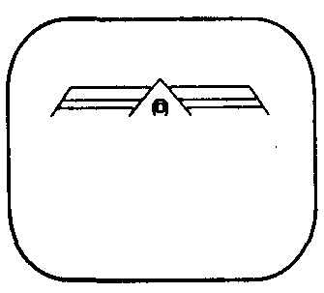
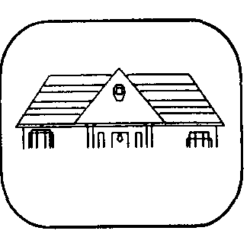
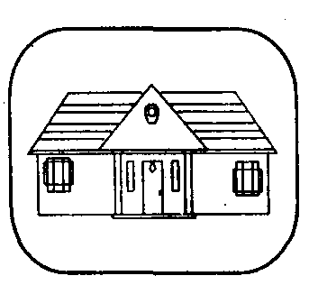
Sequential picture presentation used in the lossy DCT-based mode.

Slide 35
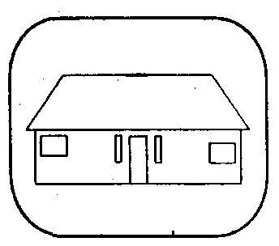
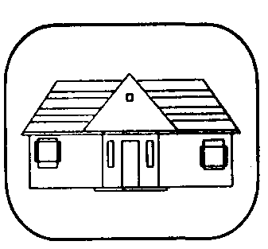
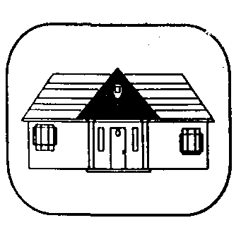
Progressive picture presentation used in the expanded Lossy DCT-based mode.

Slide 36
H.261(px64)
Driving force is ISDN ( Integrated Service Data Network)
2 B-channels of ISDN or part of them can be used to transfer video in addition to audio data.
So both users connected via the B-channel have to use the same codec for the video signal.
Used in dialog application
First a compressed data stream with a data rate of m*384 kbits/sec (m=1,2,…5) was forseen.

Slide 37
H.261(px64) cont…
Later n*64 kbits/sec where n=1,2,…5.
Then after due to advances in video-coding technology and necessary support of narrowband ISDN, px64kbits/sec where p=1,2,…30. developed.
This was recommended as H.261, later known as px64 as compressed data rate is px64 kbits/seconds.
Used for real time processing of coding and decoding.

Slide 38
Image preparation
Very precise image format
Refresh rate = 29.97 fps
Aspect ratio = 4:3
2 resolution format
CIF (Common Intermediate Format)
QCIF (Quarter Common Intermediate Format)
Resolution = 288 x 352 for CIF and other have low resolutions.
The data rate is variable depending on the format.

Slide 39
Coding Algorithm
Two different methods of coding:
Intraframe coding
No advantage is taken form the redundancy between frames e.g. I-frame of MPEG
Interframe coding
Information from previous or subsequent frames is used.
Similar to P-frame encoding of MPEG
Choice of coding is made at coding process.

Slide 40
Data Stream
Data stream has hierarchical structure composed of several layers, the bottom one having the compressed image.
Characteristics
Includes information for error correction
For each image a 5 bit image number is used as a temporal reference.
Allows stop / freeze and start / play of video without any further efforts
Also possible to switch between still images and moving images
H.261 was designed for conferencing system and video telephony.

Slide 41
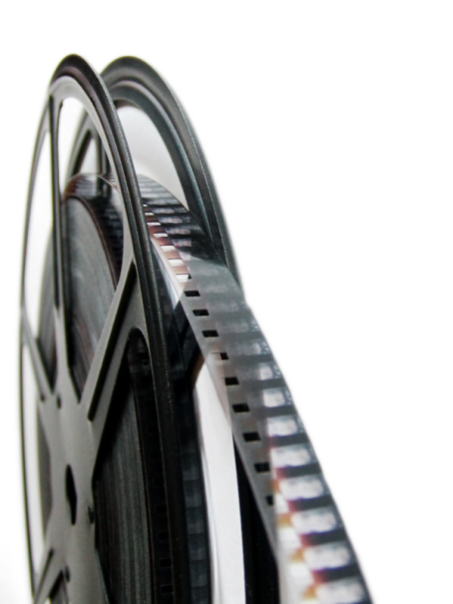
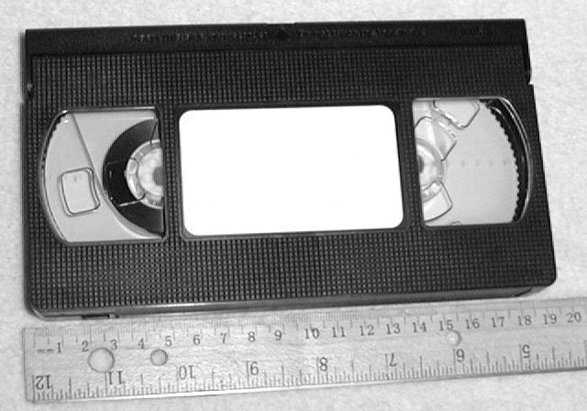
Evolution of video mediums
Film
Invented in late 18th century, still widely used today
VHS
Released in 1976, rapidly disappearing

Slide 42
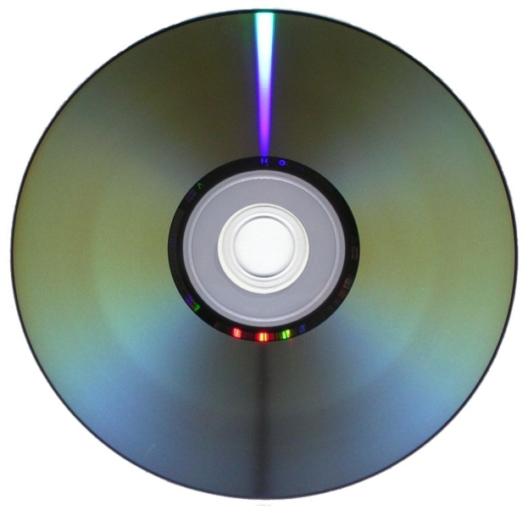
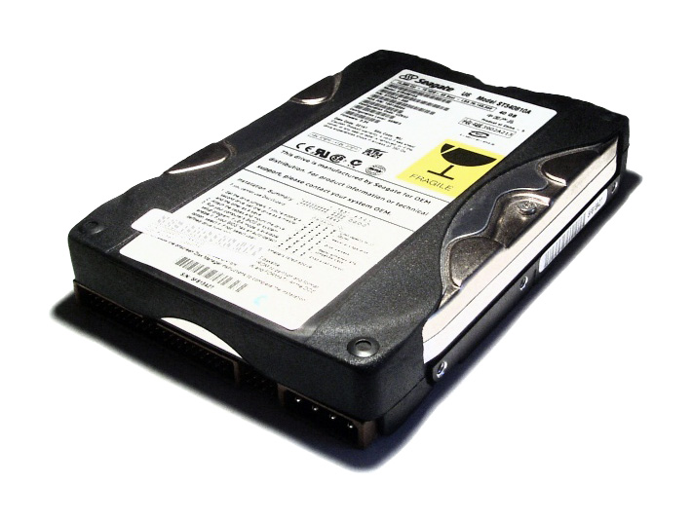
Evolution of video mediums
DVD
Released in 1996, dominant for over a decade
Hard Disk
Around for many years, only recently widely used for storing video (helped by explosion of Internet)

Slide 43
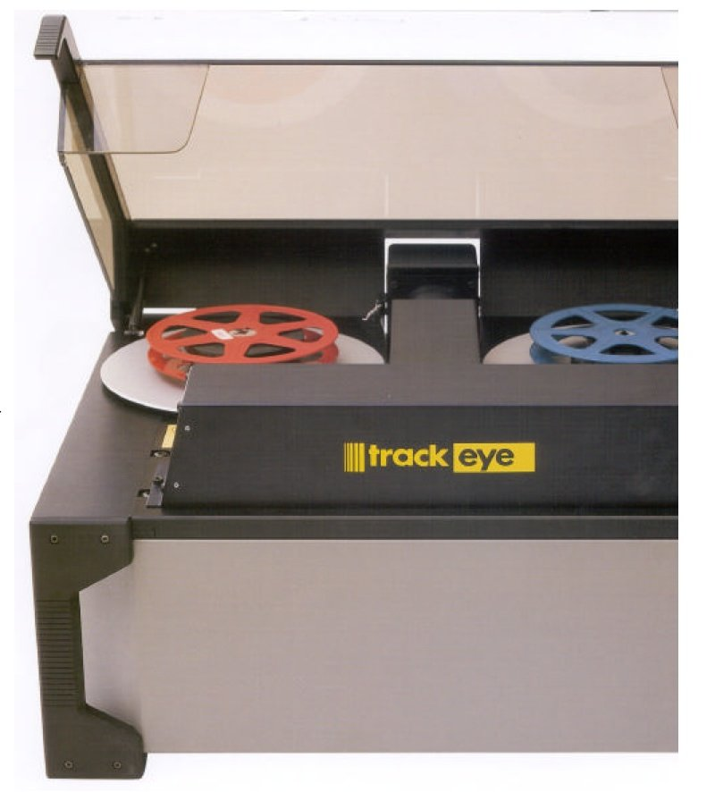
Video digitization
New digital video cameras have on-board hardware to capture directly to digital format
Old film can be scanned with special machines to produce digital stream

Slide 44
Video Encoding/Compression
Once video is in digital format, it makes sense to compress it
Similarly to image compression, we want to store video data as efficiently as possible
Again, we want to both maximize quality and minimize storage space and processing resources
This time, we can exploit correlation in both space and time domains

Slide 45
Definitions
Bitrate
Information stored/transmitted per unit time
Usually measured in Mbps (Megabits per second)
Ranges from < 1 Mbps to > 40 Mbps
Resolution
Number of pixels per frame
Ranges from 160x120 to 1920x1080
FPS (frames per second)
Usually 24, 25, 30, or 60
Don’t need more because of limitations of the human eye

Slide 46
MPEG: the Organization
Moving Picture Experts Group
Established in 1988
Standards under International Organization for
standardization (ISO) and International Electro
technical Commission (IEC)
Official name is: ISO/IEC JTC1 SC29 WG11

Slide 47
MPEG (Moving Pictures Expert Group)
Committee of experts that develops video encoding standards
Until recently, was the only game in town (still the most popular, by far)
Suitable for wide range of videos
Low resolution to high resolution
Slow movement to fast action
Can be implemented either in software or hardware

Slide 48
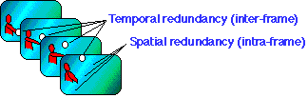
MPEG
MPEG exploits temporal (i.e frame-to-frame) redundancy present in all video sequences.
Two Categories: Intra-frame and inter-frame encoding
DCT based compression for the reduction of spatial redundancy (similar to JPEG)
Block-based motion compensation for exploiting temporal redundancy
causal(predictive coding) - current picture is modeled as transformation of picture at some previous time
non-causal (interpolative coding) - uses past and future reference

Slide 49
Evolution of MPEG
MPEG-1 : a standard for storage and retrieval of moving pictures and audio on storage media
MPEG-2 : a standard for digital television
MPEG-4 : a standard for multimedia applications
MPEG-7 : a content representation standard for information search
MPEG-21: offers metadata information for audio and video files

Slide 50
Evolution of MPEG
MPEG-1
First standard to be published by the MPEG organization (in 1992)
A standard for storage and retrieval of moving pictures and audio on storage media
Initial audio/video compression standard
Used by VCD’s
MP3 = MPEG-1 audio layer 3
Target of 1.5 Mb/s bitrate at 352x240 resolution
Only supports progressive pictures

Slide 51
Evolution of MPEG
MPEG-2
Extends video & audio compression of MPEG-1
- Substantially reduces bandwidth required for high-quality
transmissions
- Optimizes balance between resolution (quality) and bandwidth (speed)
Current de facto standard, widely used in DVD and Digital TV
Ubiquity in hardware implies that it will be here for a long time
Transition to HDTV has taken over 10 years and is not finished yet
Different profiles and levels allow for quality control
capable of coding standard-definition television at bit rate from approximately 3-15 Mbits per second and high-definition television at 15-30 Mbits per second.

Slide 52
Evolution of MPEG
MPEG-3
Originally developed for HDTV, but abandoned when MPEG-2 was determined to be sufficient
MPEG-4
Submergence
Handle specific requirements from rapidly developing multimedia applications
Advantages over MPEG-1 and MPEG-2
Object-oriented coding
MPEG-4 Part 10 is H.264, which is used in HD-DVD and Blu-Ray

Slide 53
MPEG technical specification
Part 1 - Systems - describes synchronization and multiplexing of video and audio.
Part 2 - Video - compression codec for interlaced and non-interlaced video signals.
Part 3 - Audio - compression codec for perceptual coding of audio signals. A multichannel-enabled extension of MPEG-1 audio.
Part 4 - Describes procedures for testing compliance.
Part 5 - Describes systems for Software simulation.
Part 6 - Describes extensions for DSM-CC (Digital Storage Media Command and Control.)
Part 7 - Advanced Audio Coding (AAC)
Part 8 - Deleted
Part 9 - Extension for real time interfaces.
Part 10 - Conformance extensions for DSM-CC.

Slide 54
MPEG video spatial domain processing
Spatial domain handled very similarly to JPEG
Convert RGB values to YUV colorspace
Split frame into 8x8 blocks
2-D DCT on each block
Quantization of DCT coefficients
Run length and entropy coding

Slide 55

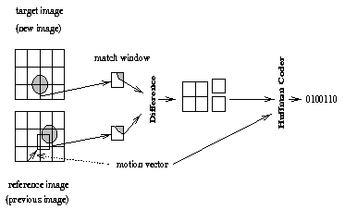
MPEG video time domain processing
Totally new ballgame (this concept doesn’t exist in JPEG)
General idea – Use motion vectors to specify how a 16x16 macroblock translates between reference frames and current frame, then code difference between reference and actual block

Slide 56
Types of frames
I frame (intra-coded)
Coded without reference to other frames
P frame (predictive-coded)
Coded with reference to a previous reference frame (either I or P)
Size is usually about 1/3rd of an I frame
B frame (bi-directional predictive-coded)
Coded with reference to both previous and future reference frames (either I or P)
Size is usually about 1/6th of an I frame

Slide 57
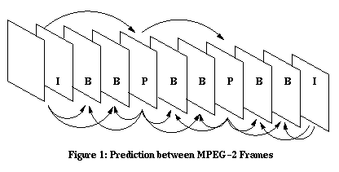
GOP (Group of Pictures)
GOP is a set of consecutive frames that can be decoded without any other reference frames
Usually 12 or 15 frames
Transmitted sequence is not the same as displayed sequence
Random access to middle of stream – Start with I frame

Slide 58
Things about prediction
Only use motion vector if a “close” match can be found
Evaluate “closeness” with MSE or other metric
Can’t search all possible blocks, so need a smart algorithm
If no suitable match found, just code the macroblock as an I-block
If a scene change is detected, start fresh
Don’t want too many P or B frames in a row
Predictive error will keep propagating until next I frame
Delay in decoding

Slide 59
Bitrate allocation
CBR – Constant BitRate
Streaming media uses this
Easier to implement
VBR – Variable BitRate
DVD’s use this
Usually requires 2-pass coding
Allocate more bits for complex scenes
This is worth it, because you assume that you encode once, decode many times

Slide 60
MPEG audio
MPEG-1 – 3 layers of increasing quality, layer 3 being the most common (MP3)
16 bits
Samping rate - 32, 44.1, or 48 kHz
Bitrate – 32 to 320 kbps
De facto - 44.1 kHz sample rate, 192 kbps bitrate
MPEG-2 – Supports > 2 channels, lower sampling frequencies, low bitrate improvement
AAC (Advanced Audio Coding)
More sample frequencies (8 kHz to 96 kHz)
Higher coding efficiency and simpler filterbank
96 kbps AAC sounds better than 128 kbps MP3
Usually CBR, but can do VBR

Slide 61
MPEG Audio Encoding Steps
Psychoacoustic
Model
Filter Bank
Transformation from time to frequency domain
32 subbands
Quantization
Bit/noise
Allocation
If noise level is too high --> rough quantization is applied
If noise level is too low --> finer quantization is applied
Multiplexer
Entropy Coder
Huffman Coding
Compressed data

Slide 62
MPEG Container Format
Container format is a file format that can contain data compressed by standard codecs
2 types for MPEG
Program Stream (PS) – Designed for reasonably reliable media, such as disks
Transport Stream (TS) – Designed for lossy links, such as networks or broadcast antennas

Slide 63
AV Synchronization
Want audio and video streams to be played back in sync with each other
Video stream contains “presentation timestamps”
MPEG-2 clock runs at 90 kHz
Good for both 25 and 30 fps
PCR (Program Clock Reference) timestamps are sent with data by sender
Receiver uses PLL (Phase Lock Loop) to synchronize clocks

Slide 64
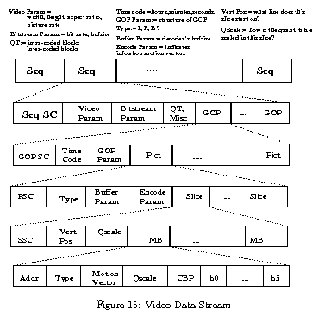
MPEG data stream

Slide 65
DVI (digital video Interactive)
DVI includes Coding algorithms.
Fundamental components are:
A VLSI chip for video subsystem
A well specified data format for audio and video files
An application user interface to the audio-visual kernel and
Compression as well as decompression algorithm.
DVI can process data, text, graphics,, still images, video and audio.

Slide 66
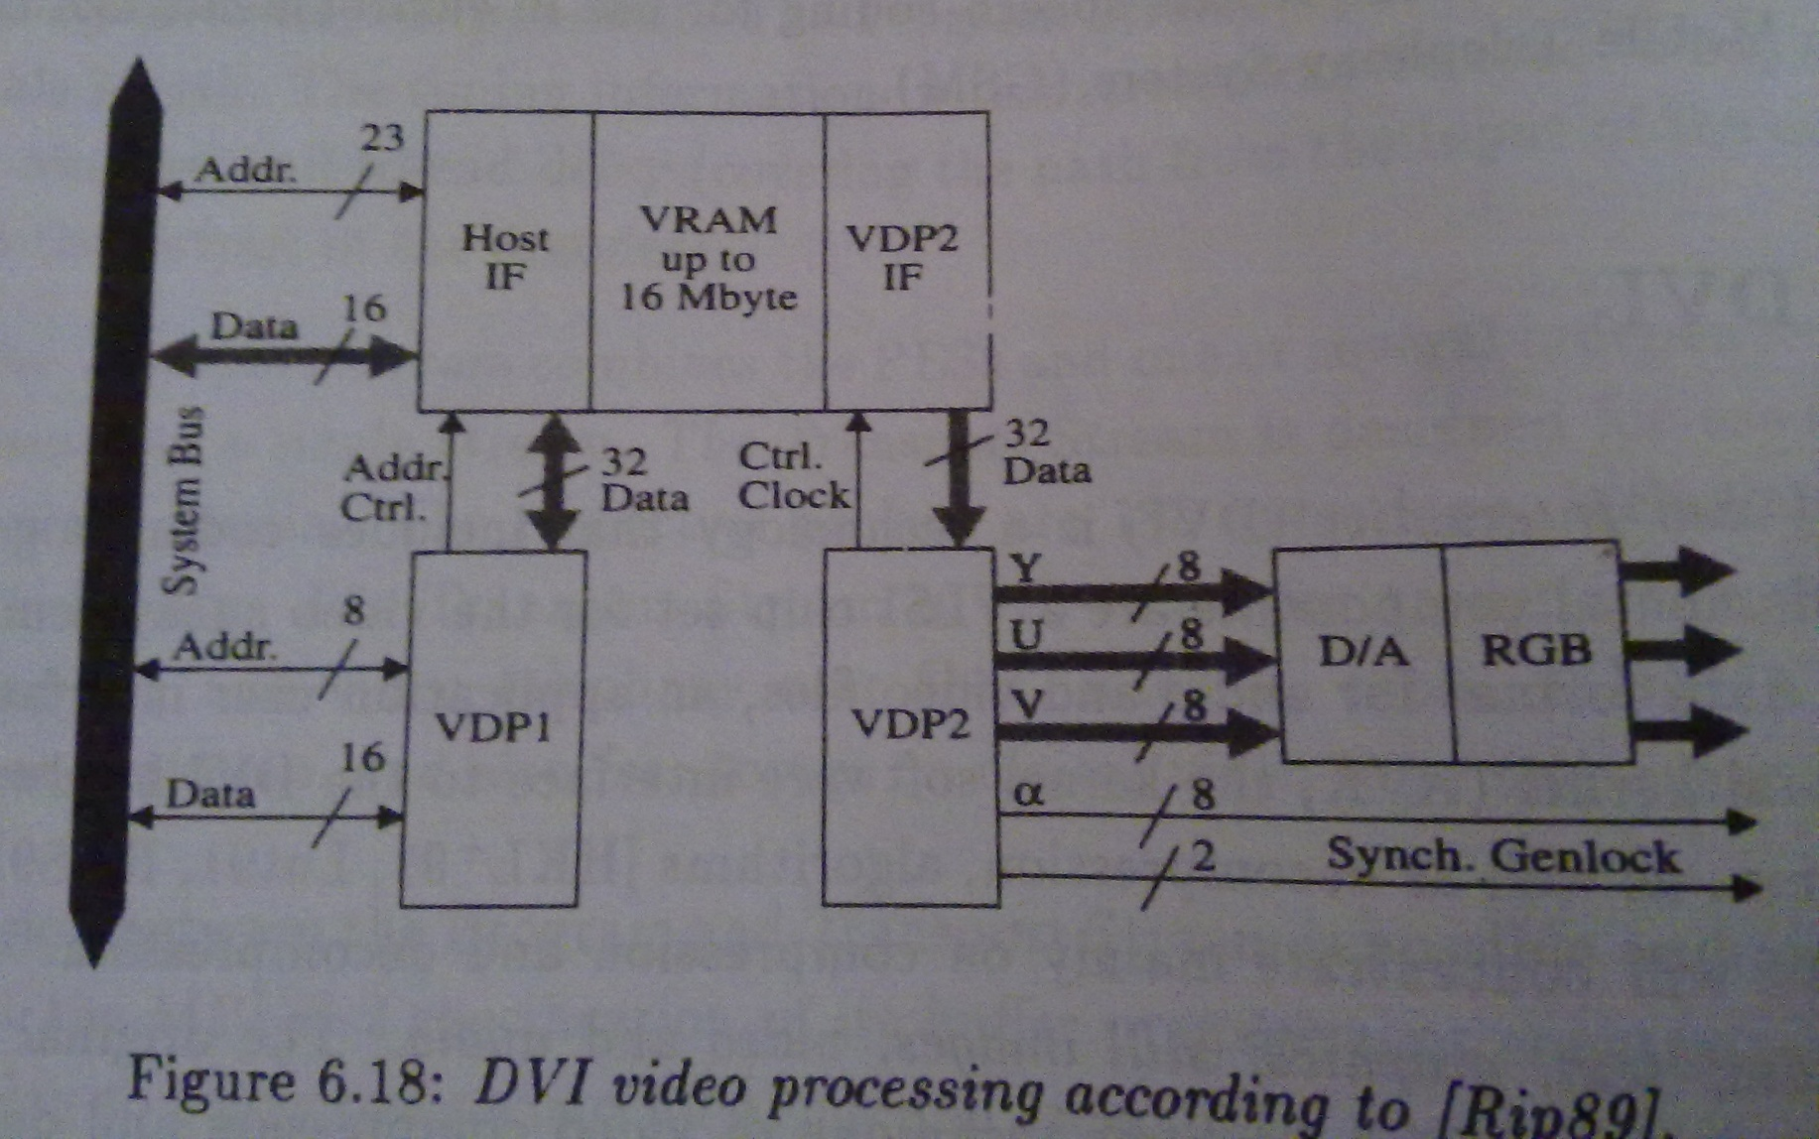
DVI
Video hardware of a DVI board:

Slide 67
Audio and Still image Encoding
Audio signals are digitized using 16 bit per sample and are either PCM-encoded or ADPCM.
When encoding still images, different video input formats can be used e.g. RGB,YUV etc.

Slide 68
Video Encoding
Two Technologies
Presentation-Level video (PLV)
Better quality at cost of time consuming asymmetric compression
Application for CD-ROM
Real-time video (RTV)
A symmetric compression technique that works with hardware and software
For interactive communication
Basic compression steps are same as for data compression i.e. Image preparation, picture processing, quantization and entropy coding.
In RTV the image preparation is decided by Audio Video Kernel (AVK).

Slide 69
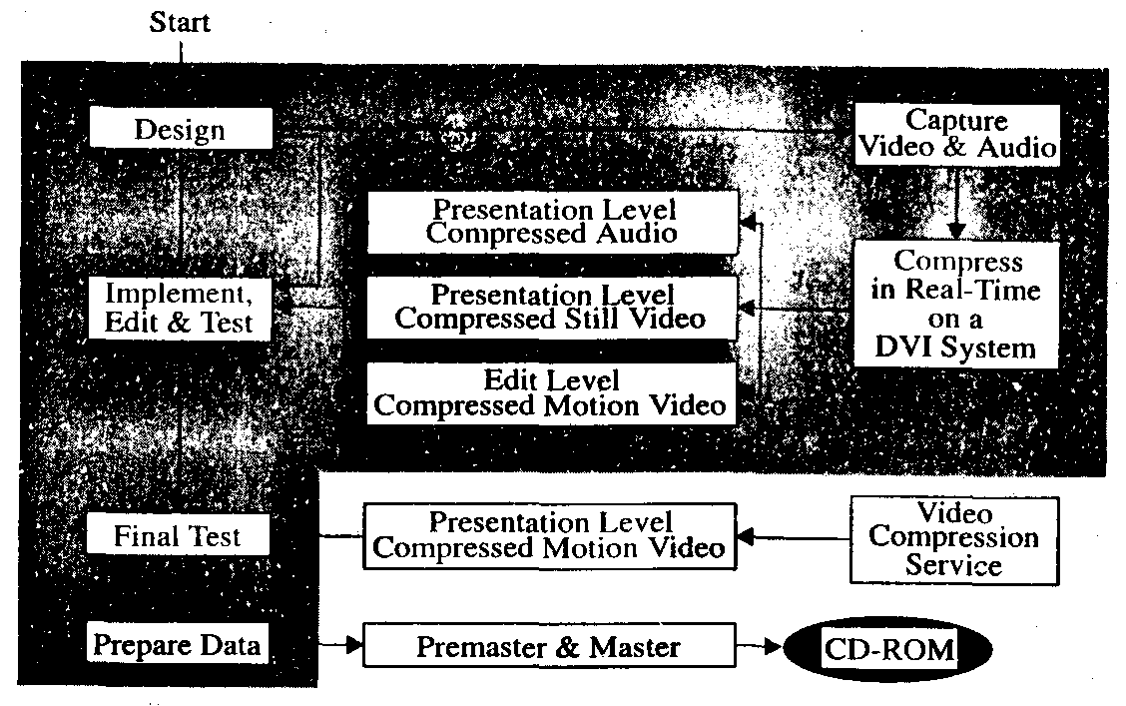
DVI generation process of a PLV
Application of DVI using PLV mode follows the process shown below:

